Slide 1
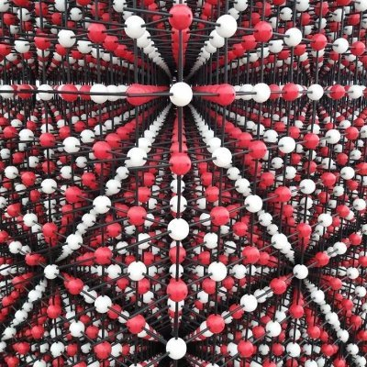
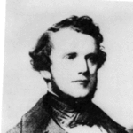
BPM: 2 Engineering Physics-II
UNIT –I: Crystal Structures and X-ray Diffraction
Lecture-2
By- Prof. B. K. Pandey, Dept. of Physics and Material Science
Auguste-Bravais

Slide 2
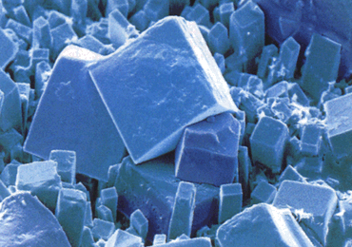
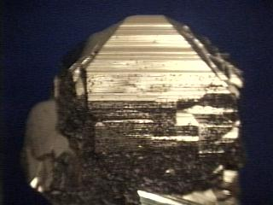
CRYSTALLOGRAPHY
What is crystallography?
The branch of science that deals with the geometric description of crystals and their internal arrangement.

Slide 3
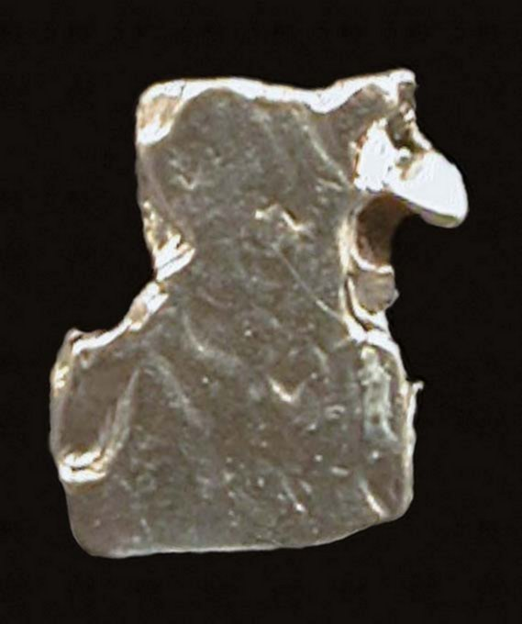
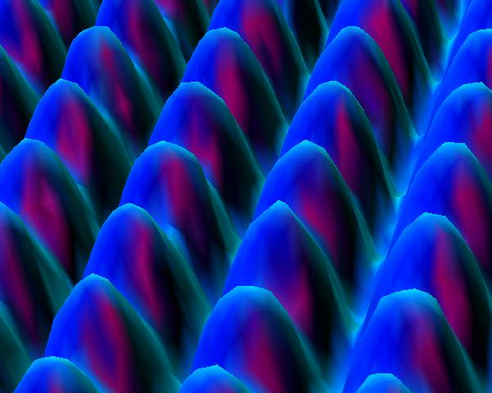
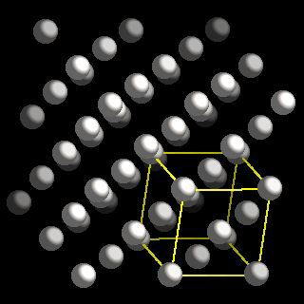
CRYSTAL LATTICE
What is crystal (space) lattice?
In crystallography, only the geometrical properties of the crystal are of interest, therefore one replaces each atom by a geometrical point located at the equilibrium position of that atom.
Platinum surface
Crystal lattice and
structure of Platinum
Platinum
(scanning tunneling microscope)

Slide 4

ELEMENTARY CRYSTALLOGRAPHY
A basic knowledge of crystallography is essential for solid state physicists;
to specify any crystal structure and
to classify the solids into different types according to the symmetries they possess.
Symmetry of a crystal can have a profound influence on its properties.
We will concern in this course with solids with simple structures.

Slide 5
Crystal Lattice
An infinite array of points in space,
Each point has identical surroundings to all others.
Arrays are arranged exactly in a periodic manner.
y
B
C
D
E
b
α
O
x
a
A

Slide 6

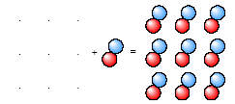
Crystal Structure
Crystal structure can be obtained by attaching atoms, groups of atoms or molecules which are called basis (motif) to the lattice sides of the lattice point.
Crystal = Crystal Lattice + Basis
Structure

Slide 7
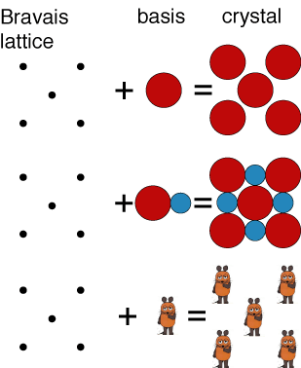
A two-dimensional Bravais lattice with different choices for the basis

Slide 8
Basis [Motif]
A group of atoms which describe crystal structure
y
y
B
B
C
D
C
D
E
b
α
b
F
G
E
x
O
x
a
O
A
a
A
H
a) Situation of atoms at the corners of regular hexagons
b) Crystal lattice obtained by identifying all the atoms in (a)

Slide 9
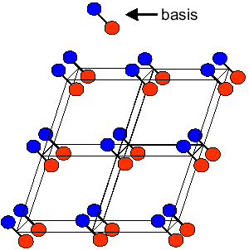
Crystal structure
Don't mix up atoms with lattice points
Lattice points are infinitesimal points in space
Lattice points do not necessarily lie at the centre of atoms
Crystal = Crystal Lattice + Basis
Structure

Slide 10
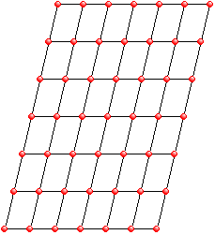
Crystal Lattice
Bravais Lattice (BL)
All atoms are of the same kind
All lattice points are equivalent
Non-Bravais Lattice (non-BL)
Atoms can be of different kind Some lattice points are not equivalent. A combination of two or more BL

Slide 11
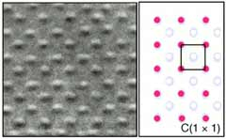
Types Of Crystal Lattices
1) Bravais lattice is an infinite array of discrete points with an arrangement and orientation that appears exactly the same, from whichever of the points the array is viewed. Lattice is invariant under a translation.
Nb film

Slide 12
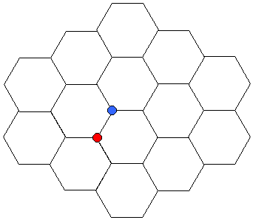
Types Of Crystal Lattices
2) Non-Bravais Lattice
Not only the arrangement but also the orientation must appear exactly the same from every point in a bravais lattice.
The red side has a neighbour to its immediate left, the blue one instead has a neighbour to its right.
Red (and blue) sides are equivalent and have the same appearance
Red and blue sides are not equivalent. Same appearance can be obtained rotating blue side 180º.
Honeycomb

Slide 13
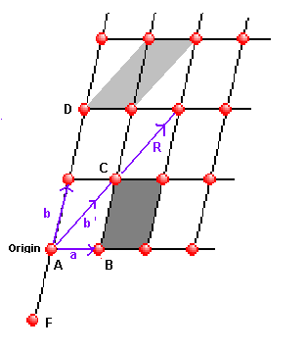
Translational Lattice Vectors – 2D
A space lattice is a set of points such that a translation from any point in the lattice by a vector;
R_{n} = n₁ a + n₂ b
locates an exactly equivalent point, i.e. a point with the same environment as P .
This is translational symmetry.
The vectors a, b are known as lattice vectors and (n₁, n₂) is a pair of integers whose values depend on the lattice point.
Point D(n1, n2) = (0,2)
Point F (n1, n2) = (0,-1)

Slide 14

Lattice Vectors – 2D
The two vectors a and b form a set of lattice vectors for the lattice.
The choice of lattice vectors is not unique. Thus one could equally well take the vectors a and b’ as a lattice vectors.

Slide 15
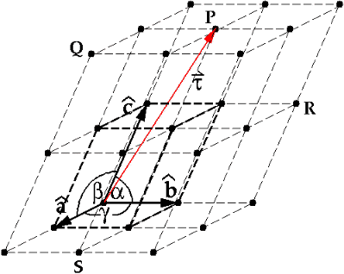
Lattice Vectors – 3D
An ideal three dimensional crystal is described by 3 fundamental translation vectors a, b and c. If there is a lattice point represented by the position vector R, there is then also a lattice point represented by the position vector where u, v and w are arbitrary integers.
R = u a + v b + w c

Slide 16
Unit Cell in 2D
The smallest component of the crystal (group of atoms, ions or molecules), which when stacked together with pure translational repetition reproduces the whole crystal.
2D-Crystal
S
S
S
S
S
b
S
S
S
S
S
a
S
S
S
S
S
Unit Cell

Slide 17
Unit Cell in 2D
The smallest component of the crystal (group of atoms, ions or molecules), which when stacked together with pure translational repetition reproduces the whole crystal.
2D-Crystal
S
The choice of
unit cell
is not unique.
S
b
S
S
a

